Slide 1
Under the Guidance of Dr.E.Vijaya Lakshmi Professor
DEPARTMENT OF ELECTRONICS & COMMUNICATION ENGINEERING
ACCIDENT DETECTION AND ALERT SYSTEM
By
B.V.Haneesh 21711A0471
G.Tharaknadh 21711A0481
L.Sunil Reddy 21711A0489
A.Srinivasulu 21711A0467
M.Venkateswarlu 21711A0492

Slide 2
CONTENTS
Abstract
Introduction
Literature Survey
Software Required
Methodology
Working
Results
Conclusion

Slide 3
ABSTRACT
Road accidents rates are very high nowadays, especially two wheelers. Timely medical aid can help in saving lives.
This system aims to alert the nearby medical center about the accident to provide immediate medical aid.
The attached accelerometer in the vehicle senses the tilt of the vehicle to understand the seriousness of the accident. Thus the systems will make the decision and sends the information to the smartphone, connected to the accelerometer through gsm and gps modules.
The Android application in the mobile phone will send text messages to the nearest medical center and friends. Application also shares the exact location of the accident and it can save time.

Slide 4
INTRODUCTION
As per the report, a total of 4,61,312 road accidents have been reported by States and Union Territories (UTs) during the calendar year 2022, which claimed 1,68,491 lives and caused injuries to 4,43,366 persons. This marks an increase of 11.9% in accidents, 9.4% in fatalities, and 15.3% in injuries compared to the previous year.
Most of the deaths are occurred due to the lack help.
To overcome the situation,this accident detect and alert system becomes a liability to the society.

Slide 5
LITERATURE SURVEY
There are various research had done in order to minimize the accidents and to save more lives of an injured victims in an accidents.
There are many ways to detect accident of an vehicle as well as the location of vehicle.
There are many methods used to detect the accidents.In this method we use ardunio and detection sensor to detect an accident but this metod has a drawback which gives us false detection of accident.
Here we use IOT based systems to detect and alert accident.

Slide 6
SOFTWARE REQUIRED
The Arduino IDE is an open-source software, which is used to write and upload code to the Arduino boards. The IDE application is suitable for different operating systems such as Windows, Mac OS X, and Linux. It supports the programming languages C and C++. Here, IDE stands for Integrated Development Environment.
The program or code written in the Arduino IDE is often called as sketching. We need to connect the Genuino and Arduino board with the IDE to upload the sketch written in the Arduino IDE software. The sketch is saved with the extension '.ino.'

Slide 7
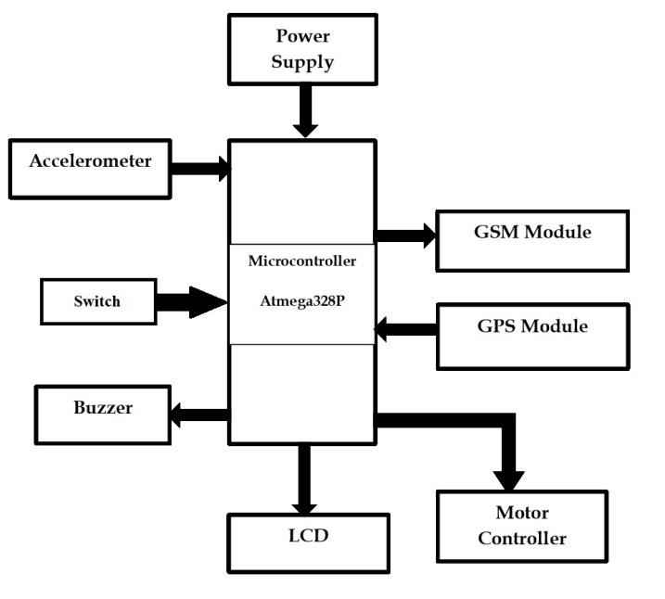
METHODOLOGY
BLOCK DIAGRAM OF ACCIDENT DETECT AND ALERT SYSTEM

Slide 8
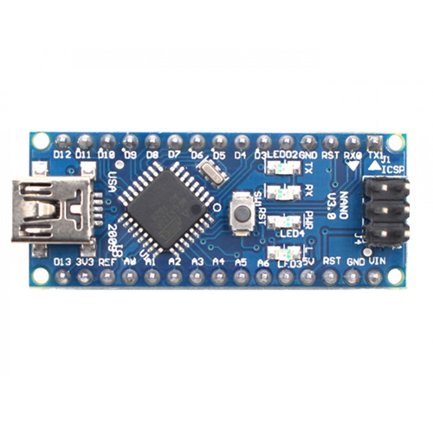
Hardware Required
ARDUINO UNO
Arduino Nano is one type of microcontroller board, and it is designed by Arduino.cc. It can be built with a microcontroller like Atmega328P.

Slide 9
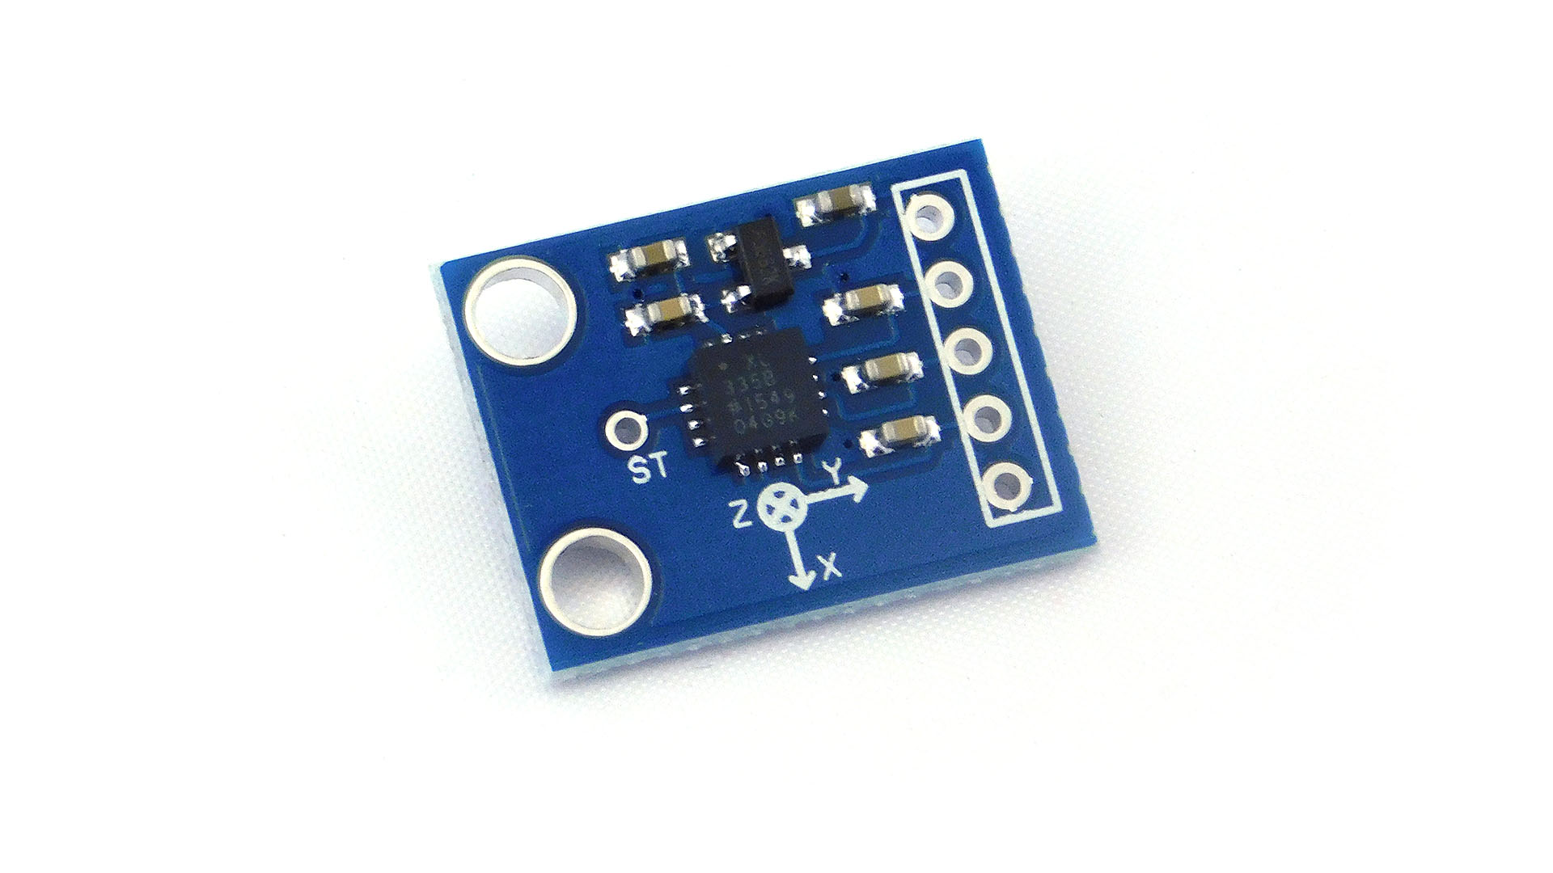
ACCELEROMETER
MPU6050 is a complete 6-axis motion tracking device. It combines of 3-axis accelerometer and 3-axis gyroscope and
digital motion processor. It helps us to measure acceleration, velocity, orientation, displacement, etc.

Slide 10
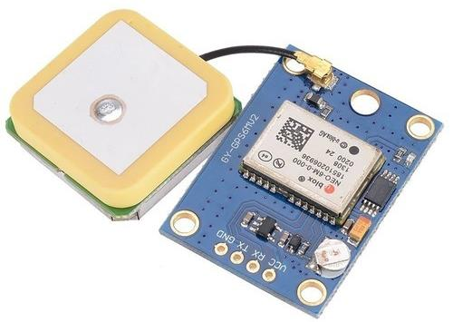
GPS MODULE
It is used to determine the ground position of an object (vehicle). Neo-6m is the high performance u-blox 6 positioning
engine. This is very flexible and cost effective receiver offer numerous connectivity option in a very small package.

Slide 11
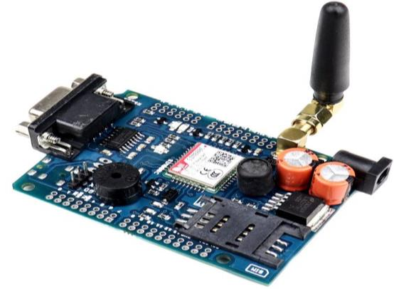
GSM Module
It is used to determine the ground position of an object (vehicle). Neo-6m is the high performance u-blox 6 positioning
engine. This is very flexible and cost effective receiver offer numerous connectivity option in a very small package.

Slide 12
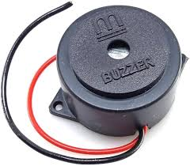
BUZZER
Whenever the accident of the vehicle occurs the buzzer start beeping.If it is a false alarm ,we can press the puss button to stop the buzzer.

Slide 13
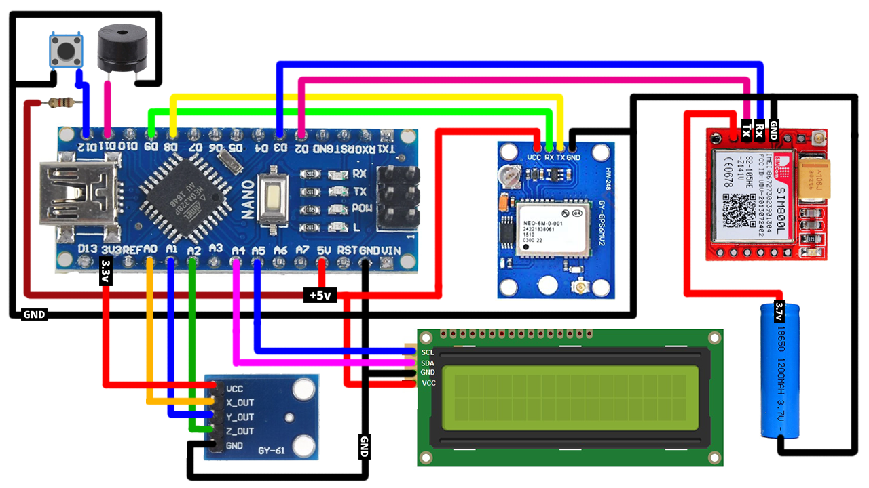
CIRCUIT DIAGRAM OF ACCIDENT DETECT AND ALERT SYSTEMS

Slide 14
WORKING
The ATmega328P is the heart of the system. The power supply of output voltage 5-6V is sufficient for the system to work.
The output of the accelerometer is given input the micro controller. The GSM module is connected to the microcontroller through which the emergency message will be sent to the registered numbers.
The GSM module is connected to the input of the micro controller which will provide GPS location of the vehicle.
The switch is provided to terminate the ongoing alert message if it is necessary. And it also contains LCD, Buzzer, Motor controller, etc.

Slide 15
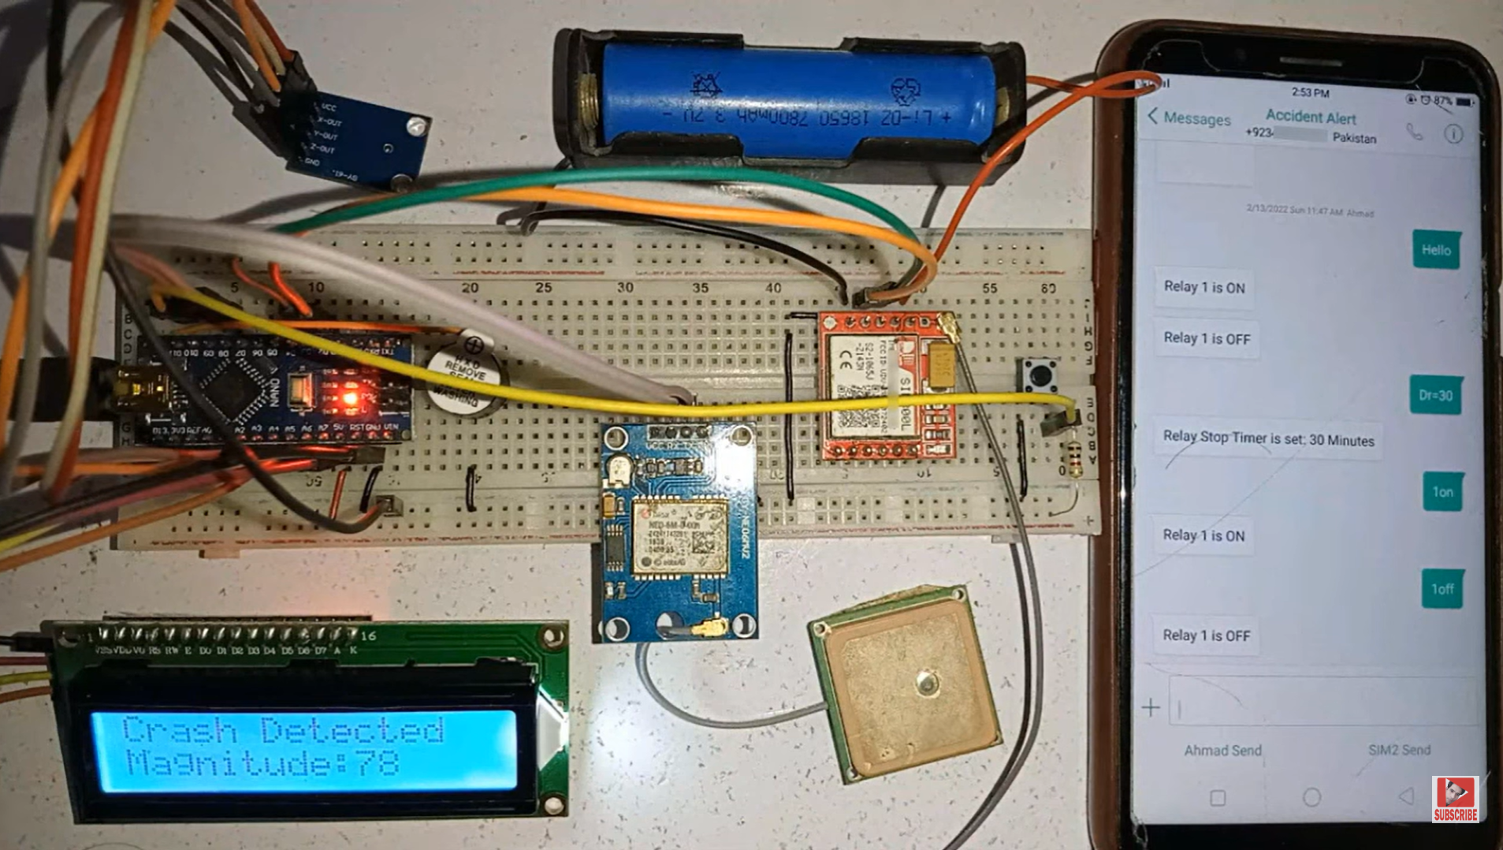
RESULTS
OUTPUT FOR ACCIDENT DETECT AND ALERT SYSTEM

Slide 16
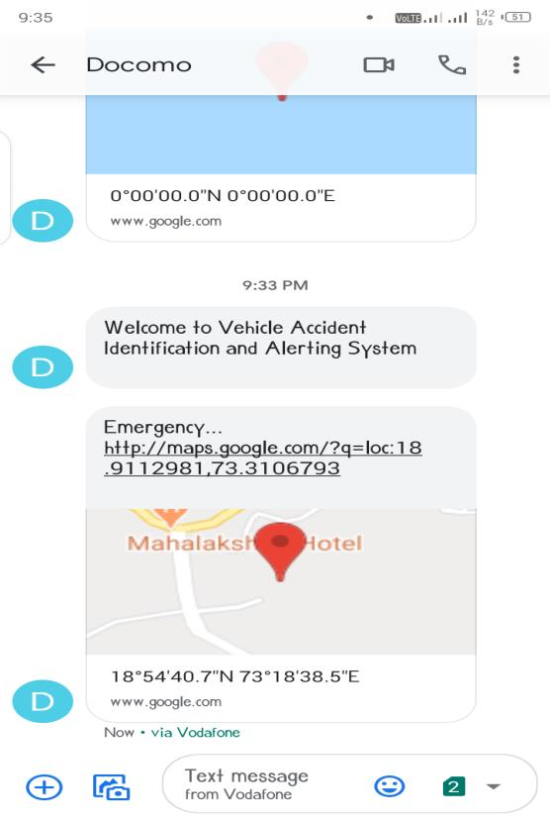
ALERT MESSAGE
Whenever the accident of the vehicle occurs the buzzer start beeping.
Then the device sends an emergency message with the accident location of the vehicle to the registered number. The received message is shown in above figure.

Slide 17
CONCLUSION
The proposed system deals with identification of the accident and alerting.
The system can detect the accident occurred and can alert registered number or nearest emergency facility. The system has the advantages of low cost, portability, small size, flexible and easy to install. The system provides best solution to poor emergency facilities provided to victim in road accidents in more convenient way.

Slide 18


